Slide 1
The world with Augmented Reality

Slide 2
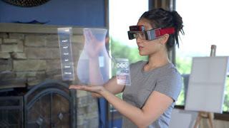
What is Augmented Reality?
The foundation of augmented reality lies in adding a layer to the real world. Augmented reality is a combination of actual reality. It adds information to the world around us and when executed you are able to interact with all of it in a very real human way.
Augmented reality takes the real world of the present, and projects digital imagery and sound into it. You will never realize the different between the real world and the augmented reality world. Using augmented reality is like watching a movie without television.

Slide 3
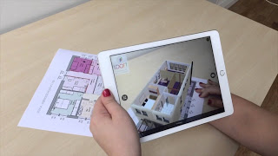
Areas where augmented reality is used
Games
Construction
Advertising
Sport
The arts
Healthcare
Architecture
Entertainment

Slide 4
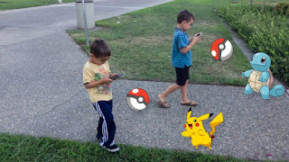
Augmented reality in Gaming
PokemonGo considered the breakthrough AR app for gaming. A map of the current environment displays on the screen and a rustle of grass indicate the presence of a Pokémon; a tap of the touchscreen brings up the capture display. In AR mode, the screen displays Pokémon in the user’s real-world environment.

Slide 5
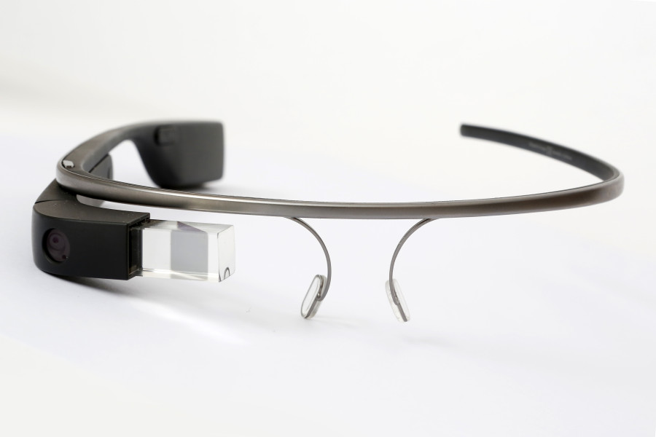
Augmented reality Equipment
Google glass
Microsoft HoloLens
Sony smart eye glass

Slide 6
Virtual Reality vs Augmented Reality
Virtual reality creates an imaginary reality while playing games and watching movies. Virtual reality makes a digital world to us.
Augmented reality makes a digital layer in the real world.
Both augmented reality and virtual reality use same technology. Augmented reality adds components to the real world. Burt virtual reality creates its’ own reality.
In virtual reality you have to stick in one place. So it can cause problems while using virtual reality in real world environment. But augmented reality is easier to use.

Slide 7
Drawbacks of Augmented reality
Diminished reality
We can remove the objects from the live videos. Everyone will live their own
life without contacting others.
Health Problems
Eye strain and psychological problems.
Addiction
People will become addicted to augmented reality applications.

Slide 8
Thank You

